Slide 1
In Memory Database
Sanjay Banthia
Harsh Takrani

Slide 2
Content
What is IMDB?
Difference between In-Memory & Traditional database
IMDB Architecture
Benefits
Pitfalls
ACID Support
Types
Is it right for your company?
References

Slide 3
IMDB
It is database management system
Data primarily relies on In-Memory (main memory) for data storage
It supports
DDL
Database schema
Database indexes
Client/server architecture

Slide 4
Difference
In-Memory | Traditional
Data stored in main memory | Data stored in disk
Data may be persistent or volatile | Data is always persistent
Size is less or limited because of less main memory | Size is large
Extra memory for cache | No extra memory
Optimized for specialized workloads | Support very broad set of workloads

Slide 5
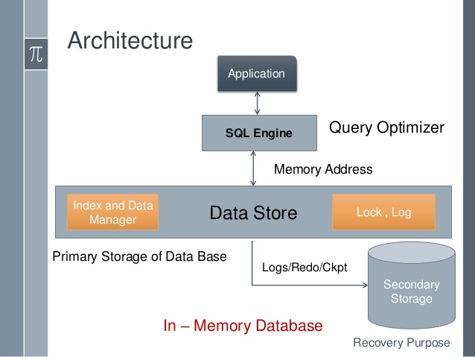
IMDB Architecture

Slide 6
Benefits
Performance
Flexibility
Reliability
Ease of use
Real time updates

Slide 7
Pitfalls
Cost
Data loss (if data is in volatile RAM)

Slide 8
ACID Support
IMDB support three of four properties i.e. Atomicity, Concurrency and Isolation
Certain mechanism made it possible to support durability also
Checkpoint
Transaction logging
Non-Volatile RAM

Slide 9
IMDB Types
VoltDB
MemSQL
SQLite
HyperSQL
MonetDB

Slide 10
Is it right for your company

Slide 11
References
https://www.3pillarglobal.com/insights/defining-in-memory-databases
http://searchdatamanagement.techtarget.com/feature/How-to-determine-if-an-in-memory-DBMS-is-right-for-your-company
https://en.wikipedia.org/wiki/In-memory_database
https://docs.microsoft.com/en-us/azure/sql-database/sql-database-in-memory
http://paristech.com/blog/in-memory-data-advantages/
https://www.slideshare.net/PridhviKodamasimham/inmemory-database

Slide 12
Thank You

